Slide 1
Week 3 Peripheral Circulatory System
Blood Pressure, Cardiac Output, and the Dive Response
ZOOL 430L

Slide 2
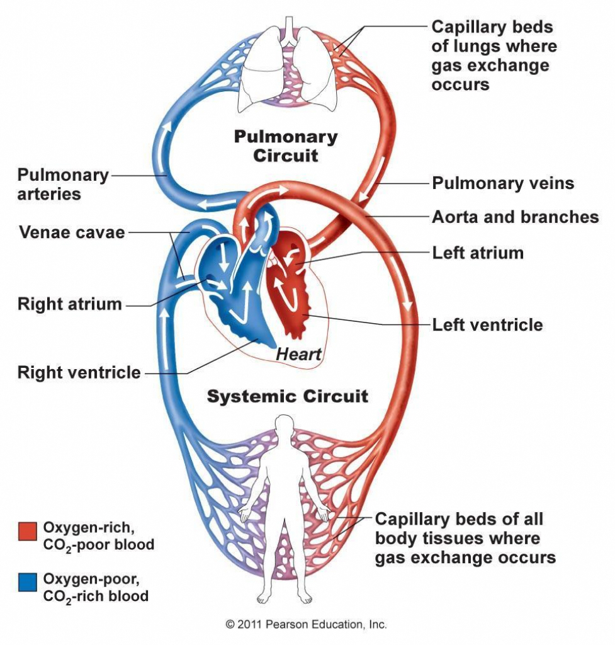
Circulatory System
Central Circulatory:
- Heart
Peripheral Circulatory:
- Artery
- Vein
- Capillary

Slide 3
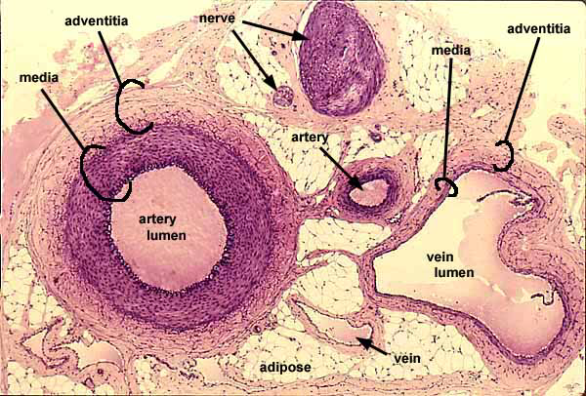
(Southern Illinois University School of Medicine)

Slide 4
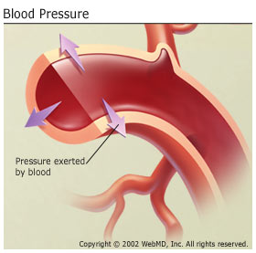
Circulatory System - cont
Blood Pressure:
Pressure exert onto the vascular wall by blood flow
Cardiac Output:
Volume of blood pumped by the heart per unit of time
CO = heart rate x stroke volume

Slide 5
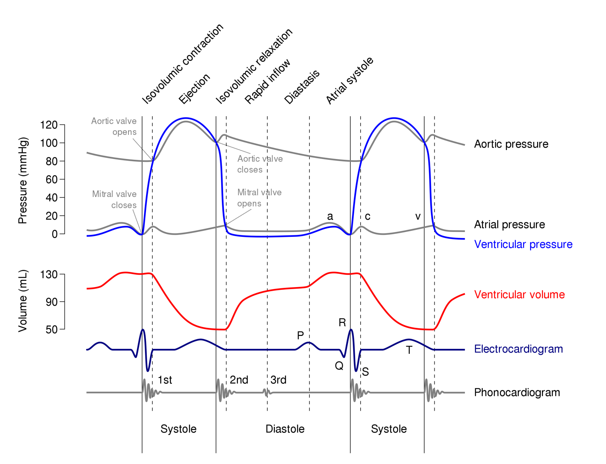
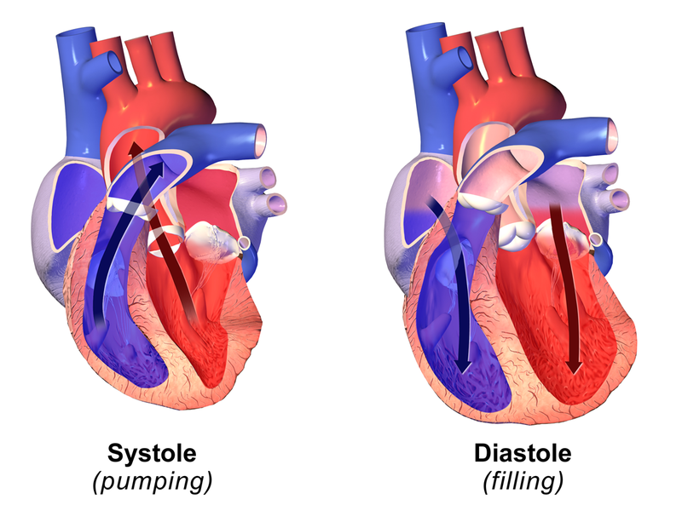
Systolic and Diastolic Pressure

Slide 6
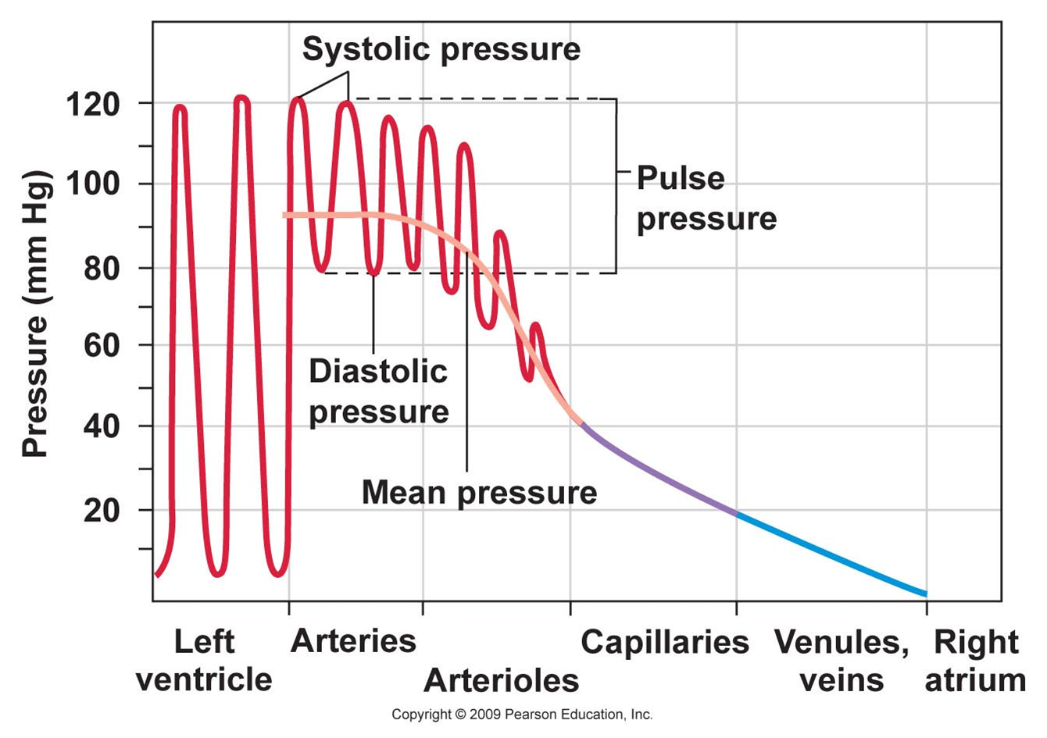

Slide 7
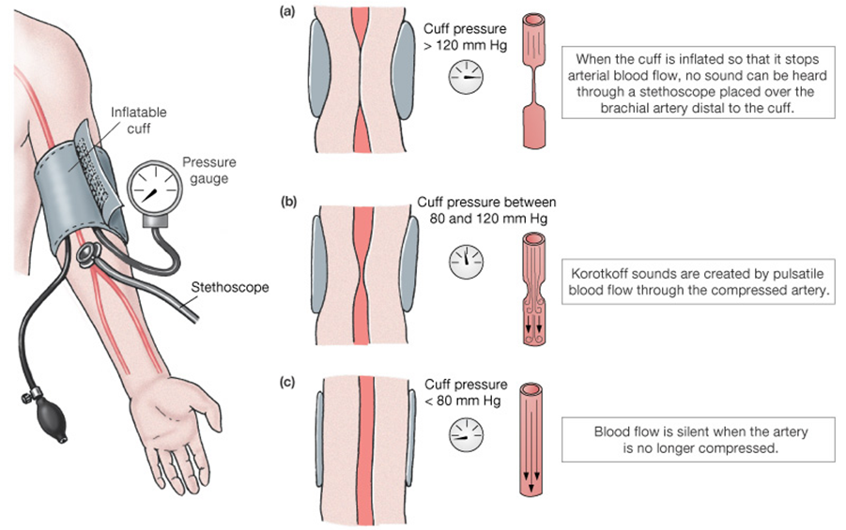
Part 1: Measuring Blood Pressure
“Sphyngomanometer”
(Won, 2004)

Slide 8
Korotkoff Sound
https://m.youtube.com/watch?v=VJrLHePNDQ4

Slide 9
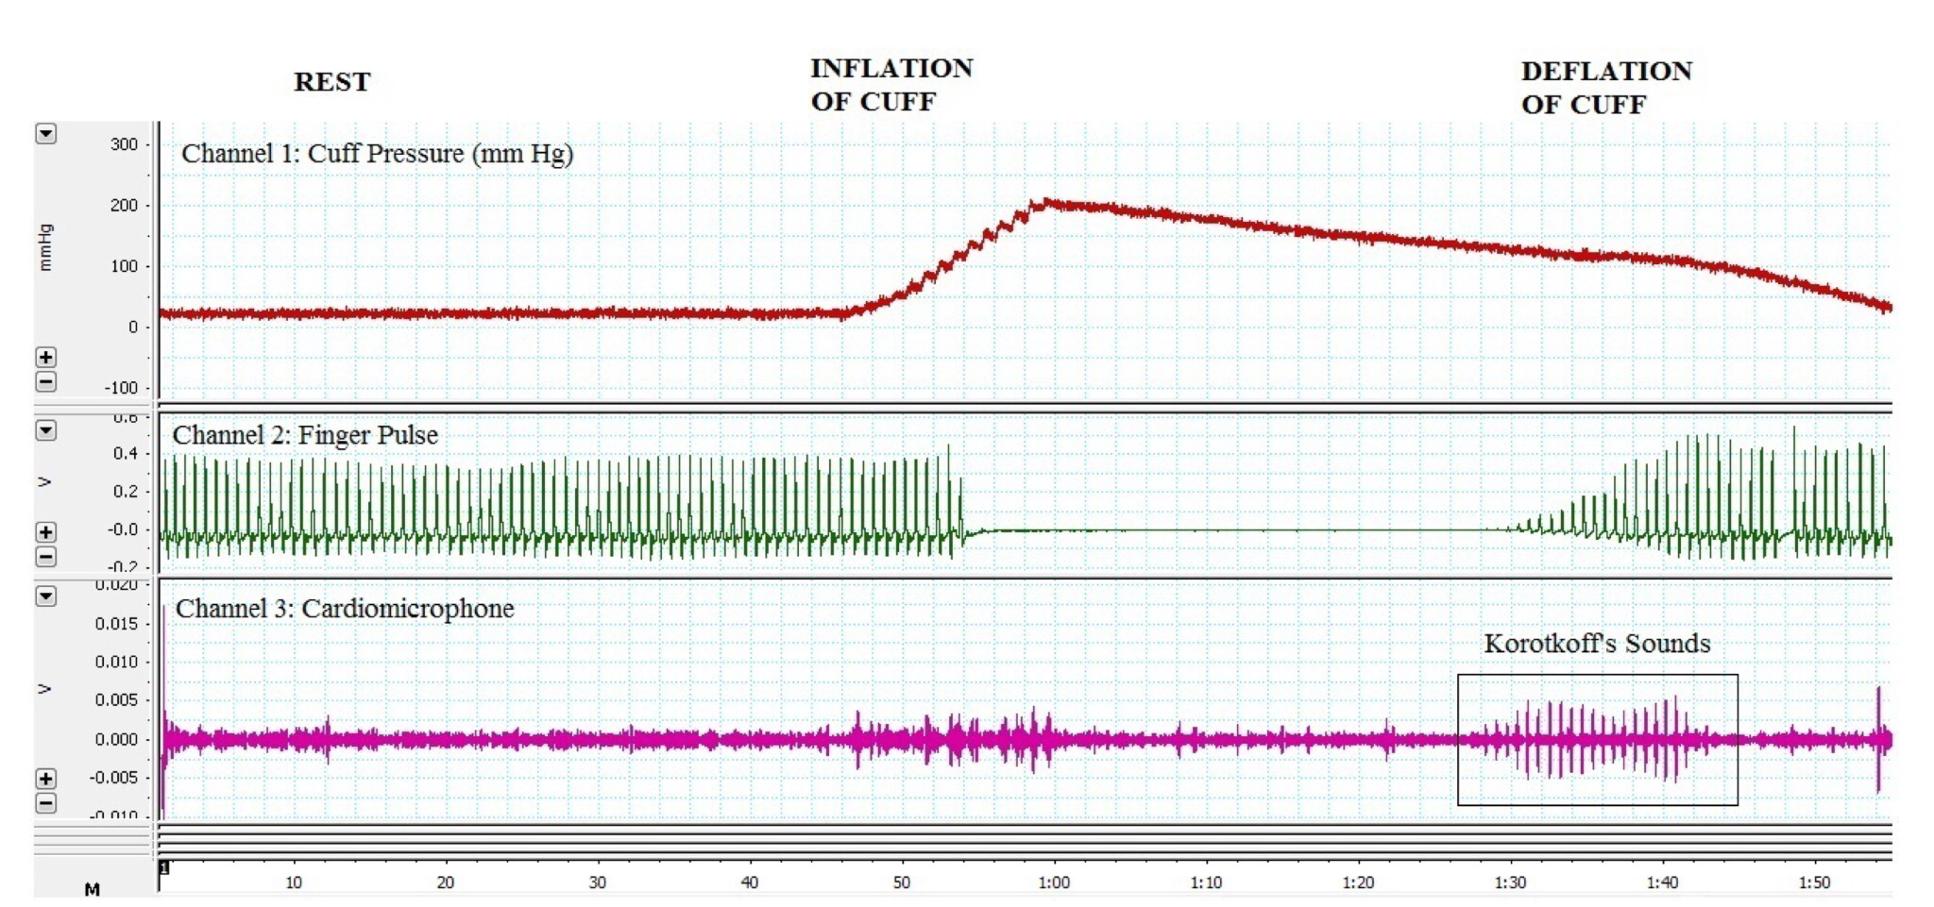
Blood Pressure Using PowerLab
(Srivastav et al. 2016)
Caution: Pressure Cuff stops the blood flow.
Follow the safety tips on the manual!
Also, don’t forget to calibrate the devise

Slide 10

Part 2: The Dive Response

Slide 11
Dive Response: Definition
Reflective response in reaction to diving underwater
Preserve heat and oxygen at vital organs: the heart, the brain
Include:
- Bradycardia
- Drop in cardiac output
- Peripheral vasoconstriction: less blood flow to the limbs

Slide 12
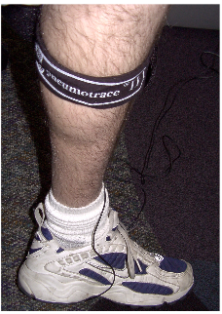
Dive Response: Experiment
Using Respiratory Belt Transducer (a force transducer) to measure leg volume
- Why?
Stop the peripheral blood flow by pressure cuff
Holding Breath in ice water
- How does the Leg volume change?

Slide 13
Work Cited
Marieb EN. & Hoehn KN., Human Anatomy & Physiology, 7th Ed (2009)
---, 8th Ed (2011)
South Illinois University School of Medicine, Histology. http://www.siumed.edu/~dking2/index.htm
Sravastav S., Sharma R. & Kapoor, R. “A Pilot Study of Evaluation of Digital Systems as an Adjunct to Sphygmomanometry for Undergraduate Teaching.” Cureus Open Access (2016).
Won, Dean. Online Human Physiology Lecture, Pasadena City College (2004). http://faculty.pasadena.edu/dkwon/lectures.htm
Butler M. “Lab #3: Blood Pressure and Peripheral Circulation.” Animal Physiology Laboratory, ZOOL 430L (2023).
Withers PC., Comparative Animal Physiology (1992).

